Slide 1
Chapter 2 Basic Concepts in RF Design
2.1 General Considerations
2.2 Effects of Nonlinearity
2.3 Noise
2.4 Sensitivity and Dynamic Range
2.5 Passive Impedance Transformation
2.6 Scattering Parameters
2.7 Analysis of Nonlinear Dynamic Systems
2.8 Volterra Series
Behzad Razavi, RF Microelectronics.
Prepared by Bo Wen, UCLA

Slide 2
Chapter Outline
Nonlinearity
Noise
Impedance
Transformation
Harmonic Distortion
Compression
Intermodulation
Dynamic Nonlinear Systems
Noise Spectrum
Device Noise
Noise in Circuits
Series-Parallel Conversion
Matching Networks
S-Parameter

Slide 3
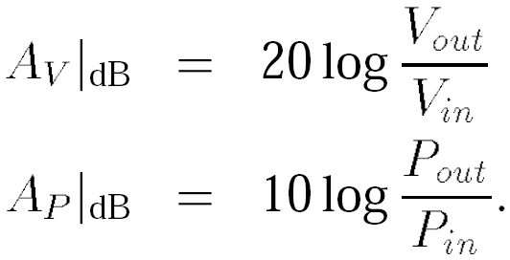
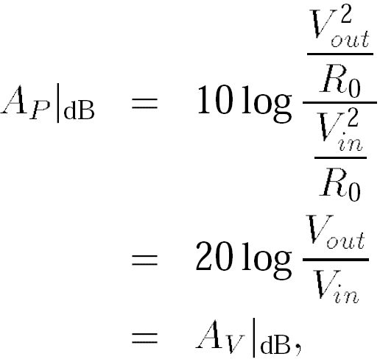
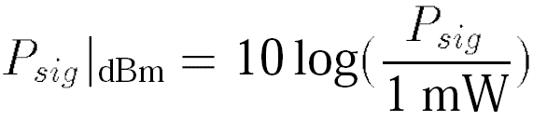
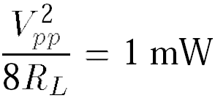

General Considerations: Units in RF Design
This relationship between Power and Voltage only holds when the input and output impedance are equal
An amplifier senses a sinusoidal signal and delivers a power of 0 dBm to a load resistance of 50 Ω. Determine the peak-to-peak voltage swing across the load.
Solution:
where R_{L}= 50 Ω thus,

Slide 4
Example of Units in RF
A GSM receiver senses a narrowband (modulated) signal having a level of -100 dBm. If the front-end amplifier provides a voltage gain of 15 dB, calculate the peak-to-peak voltage swing at the output of the amplifier.
Solution:
Since the amplifier output voltage swing is of interest, we first convert the received signal level to voltage. From the previous example, we note that -100 dBm is 100 dB below 632 mV_{pp}. Also, 100 dB for voltage quantities is equivalent to 105. Thus, -100 dBm is equivalent to 6.32 μV_{pp}. This input level is amplified by 15 dB (≈ 5.62), resulting in an output swing of 35.5 μV_{pp}.
Output voltage of the amplifier is of interest in this example

Slide 5
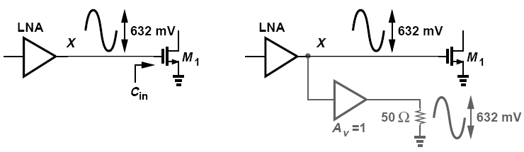
dBm Used at Interfaces Without Power Transfer
dBm can be used at interfaces that do not necessarily entail power transfer
We mentally attach an ideal voltage buffer to node X and drive a 50-Ω load. We then say that the signal at node X has a level of 0 dBm, tacitly meaning that if this signal were applied to a 50-Ω load, then it would deliver 1 mW.

Slide 6
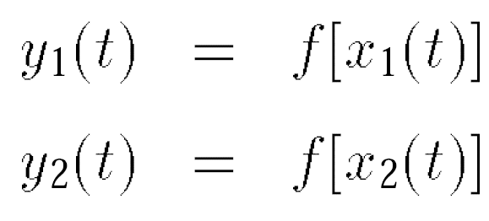
General Considerations: Time Variance
A system is linear if its output can be expressed as a linear combination (superposition) of responses to individual inputs.
A system is time-invariant if a time shift in its input results in the same time shift in its output.
If y(t) = f [x(t)]
then y(t-τ) = f [x(t-τ)]

Slide 7


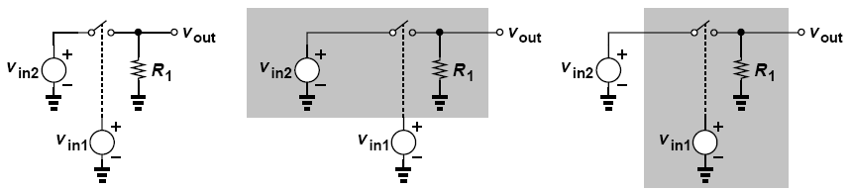
Comparison: Time Variance and Nonlinearity
time variance plays a critical role and must not be confused with nonlinearity:
Nonlinear
Time Variant
Linear
Time Variant

Slide 8
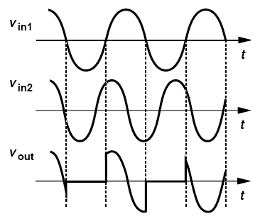
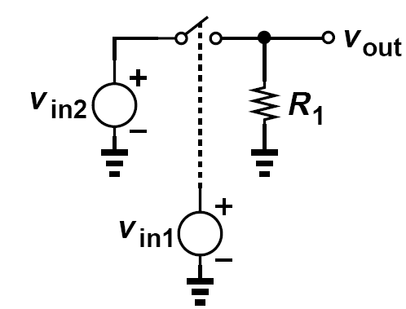
Example of Time Variance
Plot the output waveform of the circuit above if v_{in1} = A₁ cos ω₁t and v_{in2} = A₂ cos(1.25ω₁t).
Solution:
As shown above, v_{out} tracks v_{in2} if v_{in1} > 0 and is pulled down to zero by R₁ if v_{in1} < 0. That is, v_{out} is equal to the product of v_{in2} and a square wave toggling between 0 and 1.

Slide 9

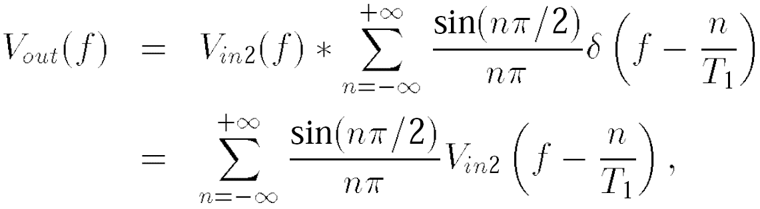
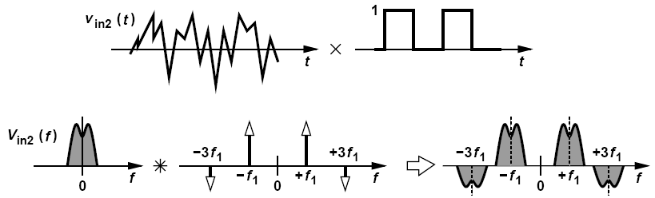
Time Variance: Generation of Other Frequency Components
A linear system can generate frequency components that do not exist in the input signal when system is time variant

Slide 10

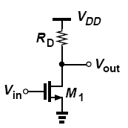
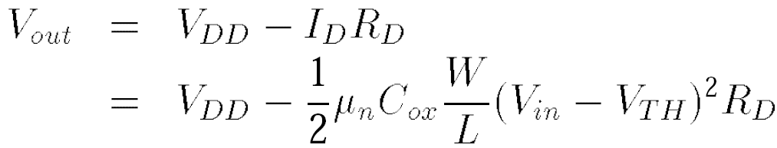
Nonlinearity: Memoryless and Static System
linear
nonlinear
The input/output characteristic of a memoryless nonlinear system can be approximated with a polynomial
In this idealized case, the circuit displays only second-order nonlinearity

Slide 11
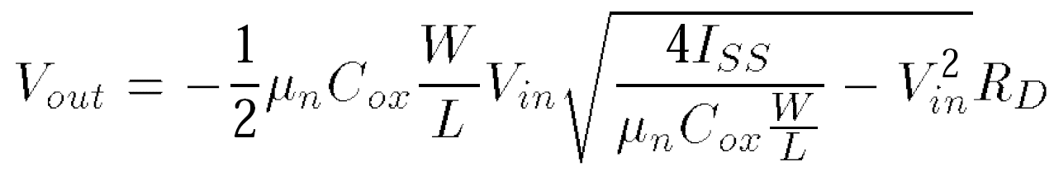
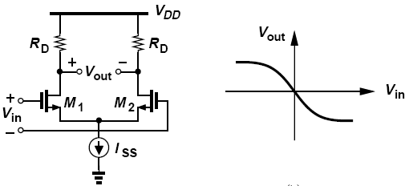
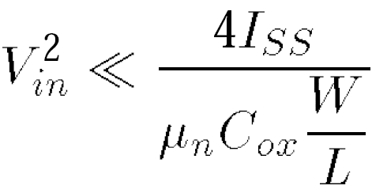
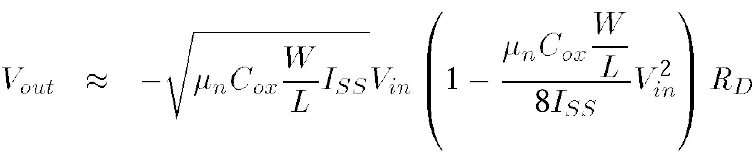
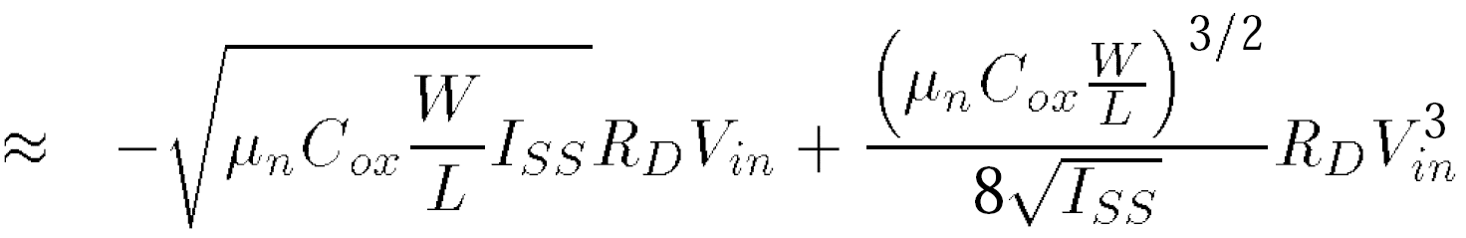
Example of Polynomial Approximation
For square-law MOS transistors operating in saturation, the characteristic above can be expressed as
If the differential input is small, approximate the characteristic by a polynomial.
Factoring 4I_{ss} / (μ_{n}C_{ox}W/L) out of the
square root and assuming
Approximation gives us:

Slide 12


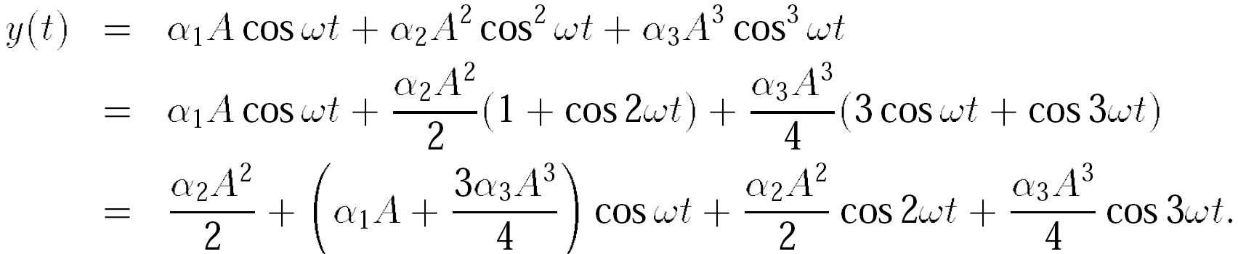
Effects of Nonlinearity: Harmonic Distortion
Linear Time-invariant Linear Time-variant
The output of a “dynamic” system depends on the past values of its input/output
DC
Fundamental
Second
Harmonic
Third
Harmonic
Even-order harmonics result from α_{j} with even j
nth harmonic grows in proportion to An

Slide 13
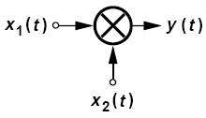
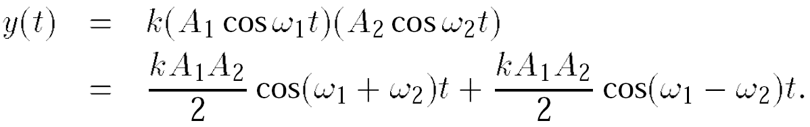
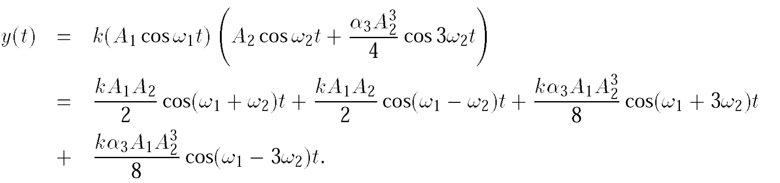
Example of Harmonic Distortion in Mixer
An analog multiplier “mixes” its two inputs below, ideally producing y(t) = kx₁(t)x₂(t), where k is a constant. Assume x₁(t) = A₁ cos ω₁t and x₂(t) = A₂ cos ω₂t.
If the mixer is ideal, determine the output frequency components.
(b) If the input port sensing x₂(t) suffers from third-order nonlinearity, determine the output frequency components.
Solution:
(a)
(b)

Slide 14
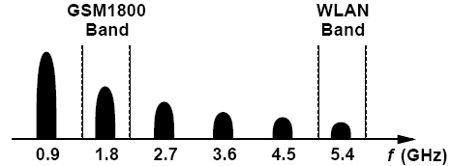
Example of Harmonics on GSM Signal
The transmitter in a 900-MHz GSM cellphone delivers 1 W of power to the antenna. Explain the effect of the harmonics of this signal.
Solution:
The second harmonic falls within another GSM cellphone band around 1800 MHz and must be sufficiently small to negligibly impact the other users in that band. The third, fourth, and fifth harmonics do not coincide with any popular bands but must still remain below a certain level imposed by regulatory organizations in each country. The sixth harmonic falls in the 5-GHz band used in wireless local area networks (WLANs), e.g., in laptops. Figure below summarizes these results.

Slide 15
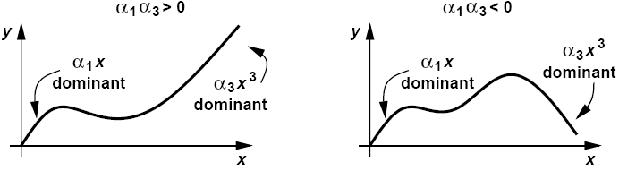
Gain Compression– Sign of α₁, α₃
Expansive
Compressive
Most RF circuit of interest are compressive, we focus on this type.

Slide 16
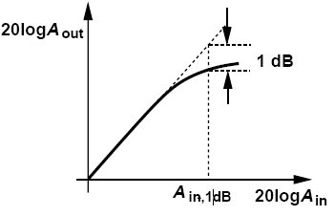
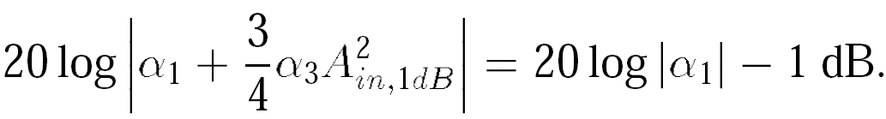
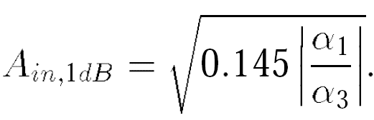
Gain Compression: 1-dB Compression Point
Output falls below its ideal value by 1 dB at the 1-dB compression point
Peak value instead of peak-to-peak value

Slide 17
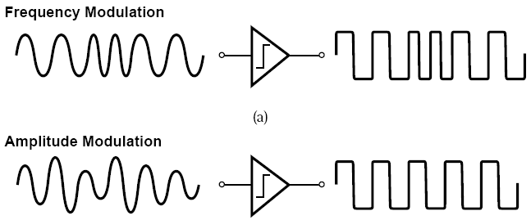
Gain Compression: Effect on FM and AM Waveforms
FM signal carries no information in its amplitude and hence tolerates compression.
AM contains information in its amplitude, hence distorted by compression

Slide 18
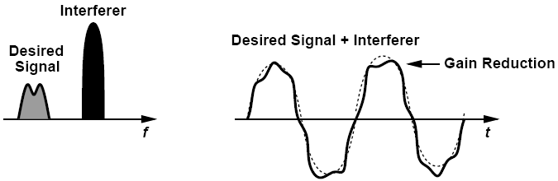
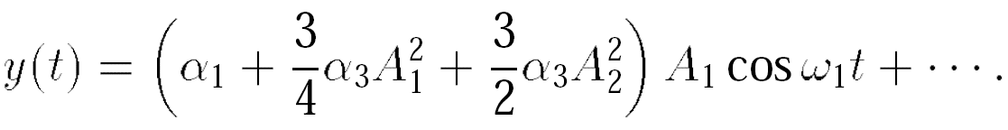
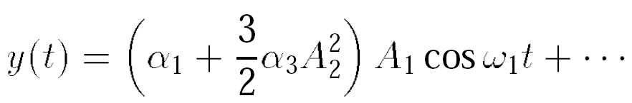
Gain Compression: Desensitization
For A₁ << A₂
Desensitization: the receiver gain is reduced by the large excursions produced by the interferer even though the desired signal itself is small.

Slide 19
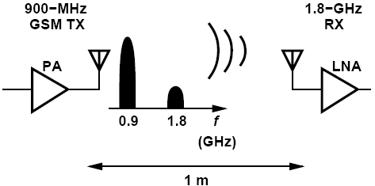
Example of Gain Compression
A 900-MHz GSM transmitter delivers a power of 1 W to the antenna. By how much must the second harmonic of the signal be suppressed (filtered) so that it does not desensitize a 1.8-GHz receiver having P_{1dB} = -25 dBm? Assume the receiver is 1 m away and the 1.8-GHz signal is attenuated by 10 dB as it propagates across this distance.
Solution:
The output power at 900 MHz is equal to +30 dBm. With an attenuation of 10 dB, the second harmonic must not exceed -15 dBm at the transmitter antenna so that it is below P_{1dB} of the receiver. Thus, the second harmonic must remain at least 45 dB below the fundamental at the TX output. In practice, this interference must be another several dB lower to ensure the RX does not compress.

Slide 20
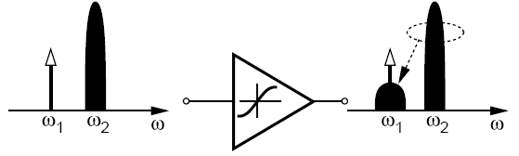

Effects of Nonlinearity: Cross Modulation
Suppose that the interferer is an amplitude-modulated signal
Thus
Desired signal at output suffers from amplitude modulation

Slide 21
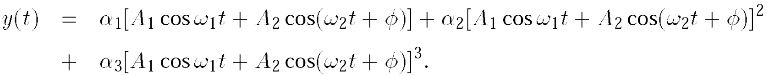
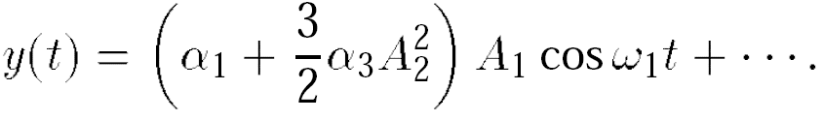
Example of Cross Modulation
Suppose an interferer contains phase modulation but not amplitude modulation. Does cross modulation occur in this case?
Solution:
Expressing the input as:
where the second term represents the interferer (A₂ is constant but Φ varies with time)
We now note that (1) the second-order term yields components at ω₁ ± ω₂ but not at ω₁; (2) the third-order term expansion gives 3α₃A₁ cos ω₁t A₂2 cos2(ω₂t+Φ), which results in a component at ω₁. Thus,
The desired signal at ω₁ does not experience cross modulation

Slide 22
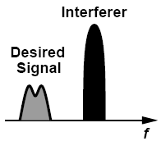
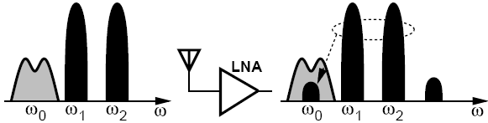
Effects of Nonlinearity: Intermodulation— Recall Previous Discussion
So far we have considered the case of:
Single Signal
Signal + one large interferer
Signal + two large interferers
Harmonic distortion
Desensitization
Intermodulation

Slide 23
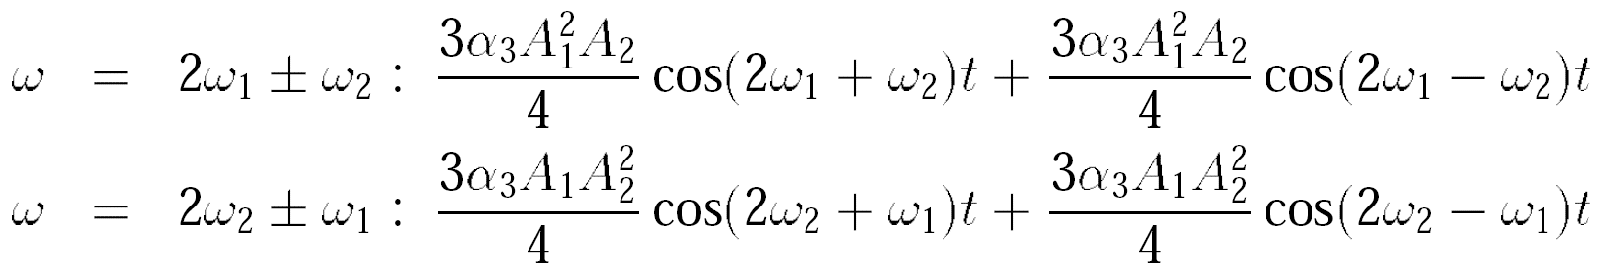
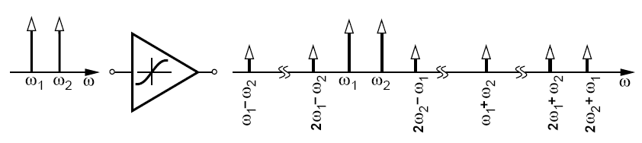
Effects of Nonlinearity: Intermodulation
assume
Thus
Intermodulation products:
Fundamental components:

Slide 24
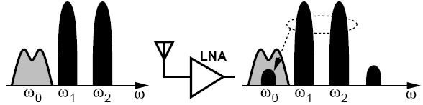

Intermodulation Product Falling on Desired Channel
Interferer
desired
A received small desired signal along with two large interferers
Intermodulation product falls onto the desired channel, corrupts signal.

Slide 25
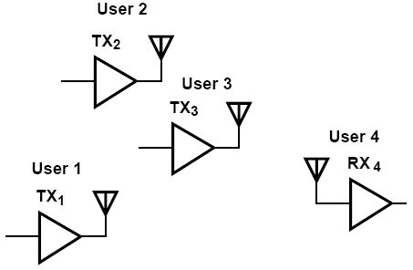
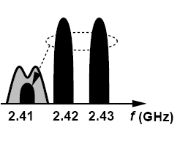
Example of Intermodulation
Suppose four Bluetooth users operate in a room as shown in figure below. User 4 is in the receive mode and attempts to sense a weak signal transmitted by User 1 at 2.410 GHz. At the same time, Users 2 and 3 transmit at 2.420 GHz and 2.430 GHz, respectively. Explain what happens.
Solution:
Since the frequencies transmitted by Users 1, 2, and 3 happen to be equally spaced, the intermodulation in the LNA of R_{X4} corrupts the desired signal at 2.410 GHz.

Slide 26
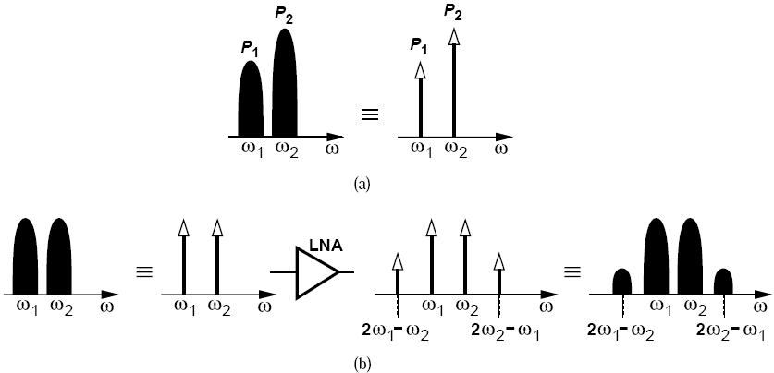
Intermodulation: Tones and Modulated Interferers
In intermodulation Analyses:
(a) approximate the interferers with tones
(b) calculate the level of intermodulation products at the output
(c) mentally convert the intermodulation tones back to modulated components
so as to see the corruption.

Slide 27
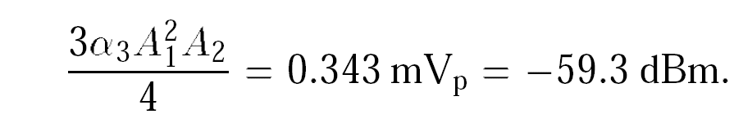
Example of Gain Compression and Intermodulation
A Bluetooth receiver employs a low-noise amplifier having a gain of 10 and an input impedance of 50 Ω. The LNA senses a desired signal level of -80 dBm at 2.410 GHz and two interferers of equal levels at 2.420 GHz and 2.430 GHz. For simplicity, assume the LNA drives a 50-Ω load.
(a) Determine the value of α₃ that yields a P_{1dB} of -30 dBm.
(b) If each interferer is 10 dB below P_{1dB}, determine the corruption experienced by the desired signal at the LNA output.
Solution:
(a) From previous equation, α₃ = 14.500 V-2
(b) Each interferer has a level of -40 dBm (= 6.32 m V_{pp}), we determine the amplitude of the IM product at 2.410 GHz as:

Slide 28
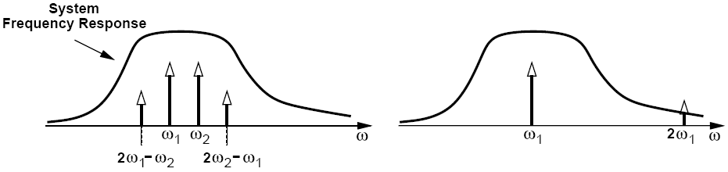
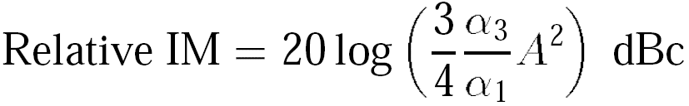
Intermodulation: Two-Tone Test and Relative IM
Two-Tone Test Harmonic Test
Two-Tone Test can be applied to systems with arbitrarily narrow bandwidths
Meaningful only when
A is given

Slide 29
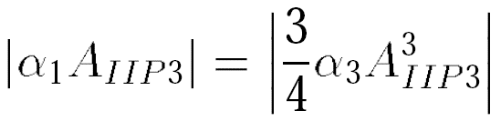
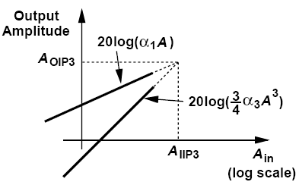
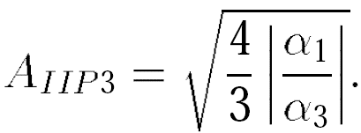
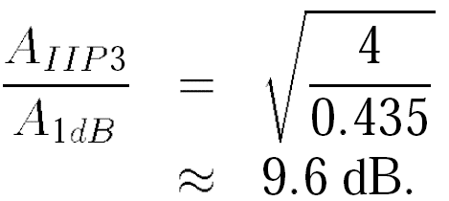

Intermodulation: Third Intercept Point
IP3 is not a directly measureable quantity, but a point obtained by extrapolation

Slide 30




Example of Third Intercept Point
A low-noise amplifier senses a -80-dBm signal at 2.410 GHz and two -20-dBm interferers at 2.420 GHz and 2.430 GHz. What IIP₃ is required if the IM products must remain 20 dB below the signal? For simplicity, assume 50-Ω interfaces at the input and output.
Solution:
At the LNA output:
Thus

Slide 31


Third Intercept Point: A reasonable estimate
For a given input level (well below P_{1dB}), the IIP₃ can be calculated by halving the difference between the output fundamental and IM levels and adding the result to the input level, where all values are expressed as logarithmic quantities.

Slide 32




Effects of Nonlinearity: Cascaded Nonlinear Stages
Considering only the first- and third-order terms, we have:
Thus,

Slide 33

Example of Cascaded Nonlinear Stages
Two differential pairs are cascaded. Is it possible to select the denominator of equation above such that IP₃ goes to infinity?
Solution:
With no asymmetries in the cascade, α₂ = β₂ = 0. Thus, we seek the condition α₃β₁ + α₁3β₃ = 0, or equivalently,
Since both stages are compressive, α₃/α₁ < 0 and β₃/β₁ < 0. It is therefore impossible to achieve an arbitrarily high IP₃.

Slide 34

Cascaded Nonlinear Stages: Intuitive results
To “refer” the IP₃ of the second stage to the input of the cascade, we must divide it by α₁. Thus, the higher the gain of the first stage, the more nonlinearity is contributed by the second stage.

Slide 35

IM Spectra in a Cascade (Ⅰ)
Let us assume _{x(t)} =Acos ω₁t + Acos ω₂t and identify the IM products in a cascade:

Slide 36


IM Spectra in a Cascade (Ⅱ)
Adding the amplitudes of the IM products, we have
Add in phase as worst-case scenario
Heavily attenuated in narrow-band circuits
For more stages:
Thus, if each stage in a cascade has a gain greater than unity, the nonlinearity of the latter stages becomes increasingly more critical because the IP3 of each stage is equivalently scaled down by the total gain preceding that stage.

Slide 37

Example of Cascaded Nonlinear Stages
A low-noise amplifier having an input IP₃ of -10 dBm and a gain of 20 dB is followed by a mixer with an input IP₃ of +4 dBm. Which stage limits the IP₃ of the cascade more?
Solution:
With α₁ = 20 dB, we note that
Since the scaled IP₃ of the second stage is lower than the IP₃ of the first stage, we say the second stage limits the overall IP₃ more.

Slide 38

Linearity Limit due to Each Stage
Examine the relative IM magnitudes at the output of each stage to find out which stage limits the linearity more

Slide 39




Effects of Nonlinearity: AM/PM Conversion
AM/PM Conversion arises in systems both dynamic and nonlinear
If R₁C₁(t)ω₁ << 1 rad
Assume that
obtaining
Phase shift of fundamental, Const.
Higher harmonic

Slide 40


AM/PM Conversion: Time-Variation of Capacitor
First order voltage dependence:
No AM/PM conversion because of the first-order dependence of C₁ on V_{out}

Slide 41


Example of AM/PM Conversion: Second Order Voltage Dependence
Suppose C₁ in above RC section is expressed as C₁ = C₀(1 + α₁V_{out} + α₂V_{out}2). Study the AM/PM conversion in this case if V_{in}(t) = V₁ cos ω₁t.
Figure below plots C₁(t) for small and large input swings, revealing that C_{avg} indeed depends on the amplitude.
The phase shift of the fundamental now contains an input-dependent term, -(α₂R₁C₀ω₁V₁2 )/2. This figure also suggests that AM/PM conversion does not occur if the capacitor voltage dependence is odd-symmetric.

Slide 42



Noise: Noise as a Random Process
Higher temperature
The average current remains equal to V_{B}/R but the instantaneous current displays random values
T must be long enough to accommodate several cycles of the lowest frequency.

Slide 43


Measurement of Noise Spectrum
To measure signal’s frequency content at 10 kHz, we need to filter out the remainder of the spectrum and measure the average power of the 10-kHz component.

Slide 44


Noise Spectrum: Power Spectral Density (PSD)
Two-Sided
One-Sided
Total area under S_{x}(f) represents the average power carried by x(t)

Slide 45



Example of Noise Spectrum
A resistor of value R₁ generates a noise voltage whose one-sided PSD is given by
where k = 1.38 × 10-23 J/K denotes the Boltzmann constant and T the absolute temperature. Such a flat PSD is called “white” because, like white light, it contains all frequencies with equal power levels.
(a) What is the total average power carried by the noise voltage?
(b) What is the dimension of S_{v}(f)?
(c) Calculate the noise voltage for a 50-Ω resistor in 1 Hz at room temperature.
(a) The area under S_{v}(f) appears to be infinite, an implausible result because the resistor noise arises from the finite ambient heat. In reality, S_{v}(f) begins to fall at f > 1 THz, exhibiting a finite total energy, i.e., thermal noise is not quite white.
(b) The dimension of S_{v}(f) is voltage squared per unit bandwidth (V2/Hz)
(c) For a 50-Ω resistor at T = 300 K

Slide 46



Effect of Transfer Function on Noise/ Device Noise
Define PSD to allow many of the frequency-domain operations used with deterministic signals to be applied to random signals as well.
Noise can be modeled by a series voltage source or a parallel current source
Polarity of the sources is unimportant but must be kept same throughout the calculations

Slide 47


Example of Device Noise
Sketch the PSD of the noise voltage measured across the parallel RLC tank depicted in figure below.
Modeling the noise of R₁ by a current source and noting that the transfer function V_{n}/I_{n1} is, in fact, equal to the impedance of the tank, Z_{T} , we write
At f₀, L₁ and C₁ resonate, reducing the circuit to only R₁. Thus, the output noise at f₀
is simply equal to 4kTR₁. At lower or higher frequencies, the impedance of the tank falls and so does the output noise.

Slide 48


Can We Extract Energy from Resistor?
Suppose R₂ is held at T = 0 K
This quantity reaches a maximum if R₂ = R₁ :
P_{R2,max} = kT
Available noise power

Slide 49



A Theorem about Lossy Circuit
If the real part of the impedance seen between two terminals of a passive (reciprocal) network is equal to Re{Z_{out}}, then the PSD of the thermal noise seen between these terminals is given by 4kTRe{Z_{out}}
An example of transmitting antenna, with radiation resistance R_{rad}

Slide 50



Noise in MOSFETS
Thermal noise of MOS transistors operating in the saturation region is approximated by a current source tied between the source and drain terminals, or can be modeled by a voltage source in series with gate.

Slide 51




Gate-induced Noise Current
At very high frequencies thermal noise current flowing through the channel couples to the gate capacitively

Slide 52






Flicker Noise and An Example
Can the flicker noise be modeled by a current source?
Yes, a MOSFET having a small-signal voltage source of magnitude V₁ in series with its gate is equivalent to a device with a current source of value g_{m}V₁ tied between drain and source. Thus,

Slide 53




Noise in Bipolar Transistors
Bipolar transistors contain physical resistances in their base, emitter, and collector regions, all of which generate thermal noise. Moreover, they also suffer from “shot noise” associated with the transport of carriers across the base-emitter junction.
In low-noise circuits, the base resistance thermal noise and the collector current shot noise become dominant. For this reason, wide transistors biased at high current levels are employed.

Slide 54

Representation of Noise in Circuits: Input-Referred Noise
Voltage source: short the input port of models A and B and equate their output noise voltage
Current source: leave the input ports open and equate the output noise voltage

Slide 55





Example of Input-Referred Noise
Calculate the input-referred noise of the common-gate stage depicted in figure below (left). Assume I₁ is ideal and neglect the noise of R₁.
Solution:
noise voltage
noise current

Slide 56

Another Example of Input-Referred Noise
Explain why the output noise of a circuit depends on the output impedance of the preceding stage.
Solution:
Modeling the noise of the circuit by input-referred sources, we observe that some of noise current flows through Z₁, generating a noise voltage at the input that depends on |Z₁|. Thus, the output noise, V_{n,out}, also depends on |Z₁|.

Slide 57


Noise Figure
Depends on not only the noise of the circuit under consideration but the SNR provided by the preceding stage
If the input signal contains no noise, NF=∞

Slide 58






Calculation of Noise Figure
NF must be specified with respect to a source impedance-typically 50 Ω
Reduce the right hand side to a simpler form:

Slide 59
Calculation of NF: Summary
Calculation of NF
Divide total output noise by the gain from V_{in} to V_{out} and normalize the result to the noise of R_{s}
Calculate the output noise due to the amplifier, divide it by the gain, normalize it to 4kTR_{s} and add 1 to the result
Valid even if no actual power is transferred. So long as the derivations incorporate noise and signal voltages, no inconsistency arises in the presence of impedance mismatches or even infinite input impedances.

Slide 60




Example of Noise Figure Calculation
Compute the noise figure of a shunt resistor R_{P} with respect to a source impedance R_{S}
Solution:
Setting V_{in} to zero:

Slide 61


Another Example of Noise Figure Calculation
Determine the noise figure of the common-source stage shown in below (left) with respect to a source impedance R_{S}. Neglect the capacitances and flicker noise of M₁ and assume I₁ is ideal.
Solution:
This result implies that the NF falls as R_{S} rises. Does this mean that, even though the amplifier remains unchanged, the overall system noise performance improves as R_{S} increases?!

Slide 62




Noise Figure of Cascaded Stages (Ⅰ)

Slide 63





Noise Figure of Cascaded Stages (Ⅱ)
This quantity is in fact the “available power gain” of the first stage, defined as the “available power” at its output, P_{out,av} (the power that it would deliver to a matched load) divided by the available source power, P_{S,av} (the power that the source would deliver to a matched load).
Called “Friis’ equation”, this result suggests that the noise contributed by each stage decreases as the total gain preceding that stage increases, implying that the first few stages in a cascade are the most critical.

Slide 64




Example of Noise Figure of Cascaded Stages
Determine the NF of the cascade of common-source stages shown in figure below. Neglect the transistor capacitances and flicker noise.
Solution:
where

Slide 65





Another Example of Noise Figure of Cascaded Stages
Determine the noise figure of the circuit shown below. Neglect transistor capacitances, flicker noise, channel-length modulation , and body effect.
Solution:

Slide 66






Noise Figure of Lossy Circuits
The power loss is calculated as:

Slide 67



Example of Noise Figure of Lossy Circuits
The receiver shown below incorporates a front-end band-pass filter (BPF) to suppress some of the interferers that may desensitize the LNA. If the filter has a loss of L and the LNA a noise figure of NF_{LNA}, calculate the overall noise figure.
Solution:
Denoting the noise figure of the filter by NF_{filt},
we write Friis’ equation as
where NF_{LNA} is calculated with respect to the output resistance of the filter. For example, if L = 1.5 dB and NF_{LNA} = 2 dB, then NF_{tot} = 3.5 dB.

Slide 68


Sensitivity and Dynamic Range: Sensitivity
The sensitivity is defined as the minimum signal level that a receiver can detect with “acceptable quality.”
Noise Floor

Slide 69
Example of Sensitivity
A GSM receiver requires a minimum SNR of 12 dB and has a channel bandwidth of 200 kHz. A wireless LAN receiver, on the other hand, specifies a minimum SNR of 23 dB and has a channel bandwidth of 20 MHz. Compare the sensitivities of these two systems if both have an NF of 7 dB.
Solution:
For the GSM receiver, P_{sen} = -102 dBm, whereas for the wireless LAN system, P_{sen} = -71 dBm. Does this mean that the latter is inferior? No, the latter employs a much wider bandwidth and a more efficient modulation to accommodate a data rate of 54 Mb/s. The GSM system handles a data rate of only 270 kb/s. In other words, specifying the sensitivity of a receiver without the data rate is not meaningful.

Slide 70

Dynamic Range Compared with SFDR
DR
SFDR
Dynamic Range:
Maximum tolerable desired signal power divided by the minimum tolerable desired signal power
SFDR:
Lower end equal to sensitivity.
Higher end defined as maximum input level in a two-tone test for which the third-order IM products do not exceed the integrated noise of the receiver

Slide 71







SFDR Calculation
Refer output IM magnitudes to input:

Slide 72



Example Comparing SFDR and DR
The upper end of the dynamic range is limited by intermodulation in the presence of two interferers or desensitization in the presence of one interferer. Compare these two cases and determine which one is more restrictive.
Solution:
Since
Noise floor
SFDR is a more stringent characteristic of system than DR

Slide 73





Passive Impedance Transformation: Quality Factor
Quality Factor, Q, indicates how close to ideal an energy-storing device is.

Slide 74








Series-to-Parallel Conversion
Q_{s}=Q_{p}

Slide 75



Parallel-to-Series Conversion
Series-to-Parallel Conversion: will retain the value of the capacitor but raises the resistance by a factor of Q_{s}2
Parallel-to-Series Conversion: will reduce the resistance by a factor of Q_{P}2

Slide 76






Basic Matching Networks
Thus,
R_{L} transformed
down by a factor
Setting imaginary part to zero
If

Slide 77

Example of Basic Matching Networks
Design the matching network of figure above so as to transform R_{L} = 50 Ω to 25 Ω at a center frequency of 5 GHz.
Solution:
Assuming Q_{P}2 >> 1, we have C₁ = 0:90 pF and L₁ = 1.13 nH, respectively. Unfortunately, however, Q_{P} = 1.41, indicating the Q_{P}2 >> 1 approximation cannot be used. We thus obtain C₁ = 0:637 pF and L₁ = 0:796 nH.

Slide 78








Transfer a Resistance to a Higher Value
If
Viewing C₂ and C₁ as one capacitor, C_{eq}
RL boosted
For low Q values

Slide 79


Another Example of Basic Matching Networks
Determine how the circuit shown below transforms R_{L}.
Solution:
We postulate that conversion of the L₁-R_{L} branch to a parallel section produces a higher resistance. If Q_{S}2 = (L₁ω/R_{L})2 >> 1, then the equivalent parallel resistance is
The parallel equivalent inductance is approximately equal to L₁ and is cancelled by C₁

Slide 80



L-Sections
For example, in (a), we have:
a network transforming R_{L} to a lower value “amplifies” the voltage and attenuates
the current by the above factor.

Slide 81



Example of L-Sections
A closer look at the L-sections (a) and (c) suggests that one can be obtained from the other by swapping the input and output ports. Is it possible to generalize this observation?
Solution:
Yes, it is. Consider the arrangement shown above (left), where the passive network transforms R_{L} by a factor of α. Assuming the input port exhibits no imaginary component, we equate the power delivered to the network to the power delivered to the load:
If the input and output ports of such a network are swapped, the resistance transformation ratio is simply inverted.

Slide 82




Impedance Matching by Transformers
More on this in Chapter 8

Slide 83






Loss in Matching Networks
We define the loss as the power provided by the input divided by that delivered to R_{L}

Slide 84



Scattering Parameters
S-Parameter: Use power quantities instead of voltage or current
The difference between the incident power (the power that would be delivered to a matched load) and the reflected power represents the power delivered to the circuit.

Slide 85




S₁₁ and S₁₂
S₁₁ is the ratio of the reflected and incident waves at the input port when the reflection from R_{L} is zero.
Represents the accuracy of the input matching
S₁₂ is the ratio of the reflected wave at the input port to the incident wave into the output port when the input is matched
Characterizes the reverse isolation

Slide 86




S₂₁ and S₂₂
S₂₁ is the ratio of the wave incident on the load to that going to the input when the reflection from R_{L} is zero
Represents the gain of the circuit
S₂₂ is the ratio of reflected and incident waves at the output when the reflection from R_{s} is zero
Represents the accuracy of the output matching

Slide 87


Scattering Parameters: A few remarks
S-parameters generally have frequency-dependent complex values
We often express S-parameters in units of dB
The condition V₂+=0 does not mean output port of the circuit must be conjugate-matched to R_{L}.

Slide 88



Input Reflection Coefficient
In modern RF design, S₁₁ is the most commonly-used S parameter as it quantifies the accuracy of impedance matching at the input of receivers.
Called the “input reflection coefficient” and denoted by G_{in}, this quantity can also be considered to be S₁₁ if we remove the condition V₂+ = 0

Slide 89


Example of Scattering Parameters (Ⅰ)
Determine the S-parameters of the common-gate stage shown in figure below (left). Neglect channel-length modulation and body effect.
Drawing the circuit as shown above (middle), where C_{X} = C_{GS} + C_{SB} and C_{Y} = C_{GD} + C_{DB}, we write Z_{in} = (1/g_{m})||(C_{X}s)-1 and
For S₁₂, we recognize that above arrangement yields no coupling from the output to the input if channel-length modulation is neglected. Thus, S₁₂ = 0.

Slide 90



Example of Scattering Parameters (Ⅱ)
Determine the S-parameters of the common-gate stage shown in figure below (left). Neglect channel-length modulation and body effect.
For S₂₂, we note that Z_{out} = R_{D}||(C_{Y} s)-1 and hence
Lastly, S₂₁ is obtained according to the configuration of figure above (right). Since V₂-/Vin = (V₂-/V_{X})(V_{X}/V_{in}), V₂- /V_{X} = g_{m}[R_{D}||R_{S}||(C_{Y} s)-1], and V_{X}/V_{in} = Z_{in}/(Z_{in} + R_{S}), we obtain

Slide 91






Analysis of Nonlinear Dynamic Systems：Basic Consideration
Input:
harmonics
Output:
IM products
If the differential equation governing the system is known, we can simply substitute for y(t) from this expression, equate the like terms, and compute a_{n}, b_{n}, c_{m,n}, and the phase shifts.

Slide 92

Analysis of Nonlinear Dynamic Systems: Harmonic Balance
We must now substitute for V_{out}(t) and V_{in}(t) in the above equation, convert products of sinusoids to sums, bring all of the terms to one side of the equation, group them according to their frequencies, and equate the coefficient of each sinusoid to zero.
This type of analysis is called “harmonic balance” because it predicts the output frequencies and attempts to balance the two sides of the circuit’s differential equation

Slide 93



Volterra Series(Ⅰ)
For a linear, time-invariant system, the output is given by
C₁ = C₀, then

Slide 94

Volterra Series(Ⅱ)
Linear responses
Nonlinear responses

Slide 95


Example of Volterra Series(Ⅰ)
Determine H₂(ω₁,ω₂) for the RC circuit with nonlinear capacitor previoius shown
Solution:
We apply the input:

Slide 96


Example of Volterra Series(Ⅱ)
Determine H₂(ω₁,ω₂) for the RC circuit with nonlinear capacitor previoius shown
Consider the terms containing ω₁+ω₂:

Slide 97




Another Example of Volterra Series
If an input V₀exp(jω₁t) is applied to the RC circuit with nonlinear capacitor, determine the amplitude of the second harmonic at the output.
Solution:
As mentioned earlier, the component at 2ω₁ is obtained as H₂(ω₁, ω₁)V₀2 exp[j(ω₁ + ω₁)t] Thus, the amplitude is equal to
Since

Slide 98

Volterra Series: Nth-Order Terms
H_{m} is called the m-th Volterra kernel

Slide 99

Example of Volterra Kernel Calculation
Determine the third Volterra kernel for the same circuit discussed above.
Solution:
assume
Introduce the short hands
Substitute for V_{out} and V_{in}, grouping all of the terms

Slide 100
Volterra Series: Harmonic Method
1. Assume V_{in}(t) = V₀ exp(jω₁t) and V_{out}(t) = H₁(ω₁)V₀ exp(jω₁t). Substitute for V_{out} and V_{in}
in the system’s differential equation, group the terms that contain exp(jω₁t), and compute the first (linear) kernel, H₁(ω₁).
2. Assume V_{in}(t) = V₀ exp(jω₁t) + V₀ exp(jω₂t) and V_{out}(t) = H₁(ω₁)V₀ exp(jω₁t) + H₁(ω₂)V₀exp(jω₂t)+H₂(ω₁; ω₂)V₀2 exp[j(ω₁ +ω₂)t]. Make substitutions in the differential equation, group the terms that contain exp[j(ω₁ + ω₂)t], and determine the second kernel, H₂(ω₁; ω₂).
3. Assume V_{in}(t) = V₀ exp(jω₁t) + V₀ exp(jω₂t) + V₀ exp(jω₃t) and V_{out}(t) is given. Make substitutions, group the terms that contain exp[j(ω1 + ω2 + ω3)t], and calculate the
third kernel, H₃(ω1; ω2; ω3).
4. To compute the amplitude of harmonics and IM components, choose ω₁, ω₂, · · · properly. For example, H₂(ω₁; ω₁) yields the transfer function for 2ω₁ and H₃(ω₁;-ω₂; ω₁) the transfer function for 2ω₁ - ω₂.

Slide 101
Volterra Series: Method of Nonlinear Currents
1. Assume V_{in}(t) = V₀ exp(jω₁t) and determine the linear response of the circuit by ignoring
the nonlinearity. The “response” includes both the output of interest and the voltage across the nonlinear device.
2. Assume V_{in}(t) = V₀ exp(jω₁t) + V₀ exp(jω₂t) and calculate the voltage across the nonlinear
device, assuming it is linear. Now, compute the nonlinear component of the current flowing through the device, assuming the device is nonlinear.
3. Set the main input to zero and place a current source equal to the nonlinear component found in Step 2 in parallel with the nonlinear device.
4. Ignoring the nonlinearity of the device again, determine the circuit’s response to the current source applied in Step 3. Again, the response includes the output of interest and the voltage across the nonlinear device.
5. Repeat Steps 2, 3, and 4 for higher-order responses. The overall response is equal to the output components found in Steps 1, 4, etc.

Slide 102



Example Using Method of Nonlinear Currents (Ⅰ)
Determine H₃(ω₁,ω₂,ω₃) for the circuit below.
Solution:
Step 1
The voltage across the capacitor is equal to:
Step 2
Compute the nonlinear current flowing through C₁

Slide 103



Example Using Method of Nonlinear Currents (Ⅱ)
Determine H₃(ω₁,ω₂,ω₃) for the circuit below.
Solution:
Step 3
Set the input to zero, assume a linear capacitor, and apply I_{C1,non(t)} in parallel with C₁
Step 4

Slide 104




Example Using Method of Nonlinear Currents (Ⅲ)
Determine H₃(ω₁,ω₂,ω₃) for the circuit below.
Step 5
The nonlinear current through C₁ is thus equal to

Slide 105




Another Example Using Method of Nonlinear Currents (Ⅰ)
Figure below shows the input network of a commonly-used LNA (Chapter 5). Assuming that g_{m}L₁/C_{GS} = R_{S} (Chapter 5) and I_{D} = α(V_{GS}-V_{TH})2, determine the nonlinear terms in I_{out}. Neglect other capacitances, channel-length modulation, and body effect.
Solution:
Step 1
Step 2
assume
This voltage results in a nonlinear current given by

Slide 106




Another Example Using Method of Nonlinear Currents (Ⅱ)
Figure below shows the input network of a commonly-used LNA (Chapter 5). Assuming that g_{m}L₁/C_{GS} = R_{S} (Chapter 5) and I_{D} = α(V_{GS}-V_{TH})2, determine the nonlinear terms in I_{out}. Neglect other capacitances, channel-length modulation, and body effect.
Solution:
Step 3&4
Thus, for s = jω

Slide 107
Another Example Using Method of Nonlinear Currents (Ⅳ)
Figure below shows the input network of a commonly-used LNA (Chapter 5). Assuming that g_{m}L₁/C_{GS} = R_{S} (Chapter 5) and I_{D} = α(V_{GS}-V_{TH})2, determine the nonlinear terms in I_{out}. Neglect other capacitances, channel-length modulation, and body effect.
Solution:
Step 5
assume
Since I_{D} = αV₁2, the nonlinear current at ω₁ + ω₂ + ω₃ is expressed as

Slide 108

References (Ⅰ)

Slide 109


References (Ⅱ)

Slide 110

References (Ⅲ)

